Slide 1
A*STARS Road Safety Quiz KS1

Slide 2
Good Luck!

Slide 3
Question 1
You don’t have to wear a seat belt in the back of a car
True or False

Slide 4
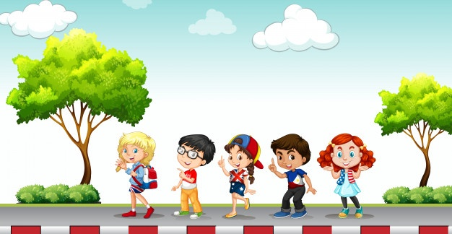
Question 2
What is a pedestrian?
Someone who helps you cross the road
The edge of the pavement
A person who walks

Slide 5
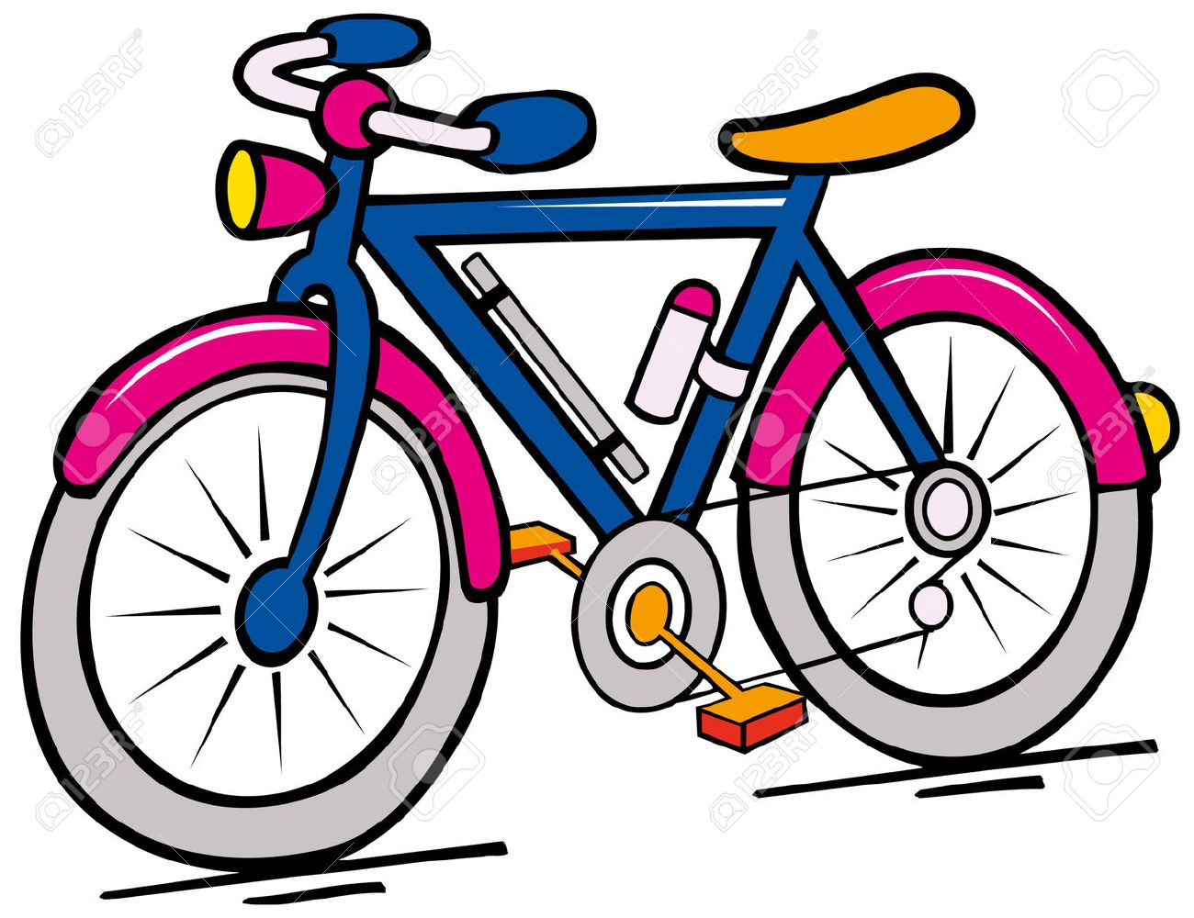
Question 3
Lights and reflectors do not need to be checked regularly on your bike
True or False

Slide 6
Question 4
Where would you place your bag when scooting?
In your hands
On your back
On your handle bars

Slide 7
Question 5
Can you guess what words are missing from road marking below?

Slide 8
Question 6
Which is the safest way to cross the road?
Diagonally
In a straight line
Zig Zag

Slide 9
Question 7
When should the following materials be worn?
Fluorescent
Reflective

Slide 10
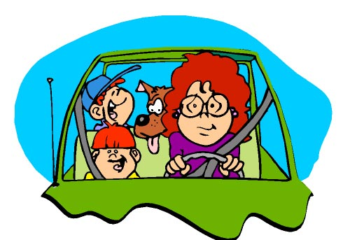
Question 8
What should you not do in a car which may distract the driver?
Sing loudly
Open the door
Talk to other passengers

Slide 11
Question 9
Can you use the words to fill the gaps in the Green Cross Code
Find a safe place to cross
_____ just before you get to the kerb
_____ all around for traffic and _____
If traffic is coming, let it pass
_____ when it is safe, go straight across the road- do not run, keep looking and listening while you cross
THINK LOOK LISTEN STOP

Slide 12
Question 10
Which of these statements is the odd one out? Active travel is good for you as it:
Strengthens your lungs
Is good for your heart
Makes your feet grow bigger
Helps you sleep better
Strengthens muscles and bones
Makes you feel better

Slide 13
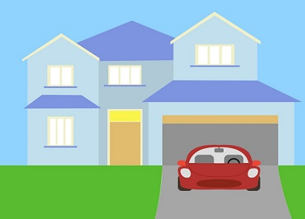
Question 11
What things tell you that a car is about to move off a driveway?
A) Driver in vehicle, smoke from exhaust, wheels turning, car lights (especially the reverse light), engine sound
B) Driver stood next to vehicle, open front door, car lights (especially the reverse light), engine sound
C) Empty car, no lights, no engine sound

Slide 14
Question 12
When getting off the bus, where should you cross the road?
In front of the bus
Wait for the bus to pull away before crossing
Behind the bus

Slide 15
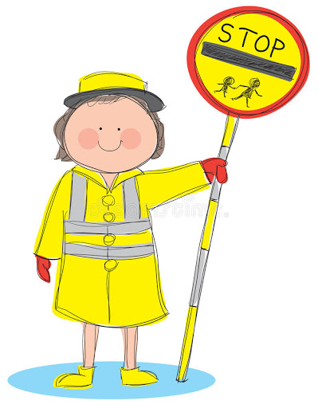
Question 13
How should you cross with a school crossing patrol?
Follow them into the road
Cross behind them
Wait for the SCP to tell you it’s safe to cross then cross in from of them

Slide 16
Question 14
At what crossing can you find a belisha beacon?
Puffin
Zebra
Toucan

Slide 17
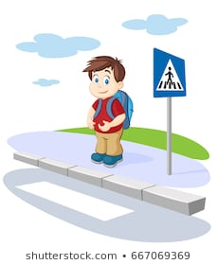
Question 15
Always try to cross at a well-lit point?
True or False

Slide 18
Question 16
Dazzle is 7 and 120cm tall, which seat should dazzle be on?
A booster seat
Back seat with a seatbelt
The front seat

Slide 19
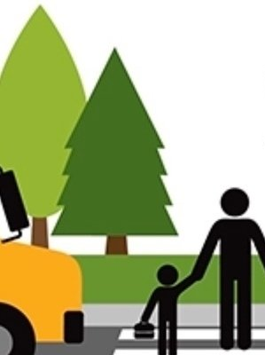
Question 17
You should always hold hands with an adult when crossing the road.
True or False

Slide 20
Question 18
You don’t need to get off your scooter and walk when crossing a road
True or False

Slide 21
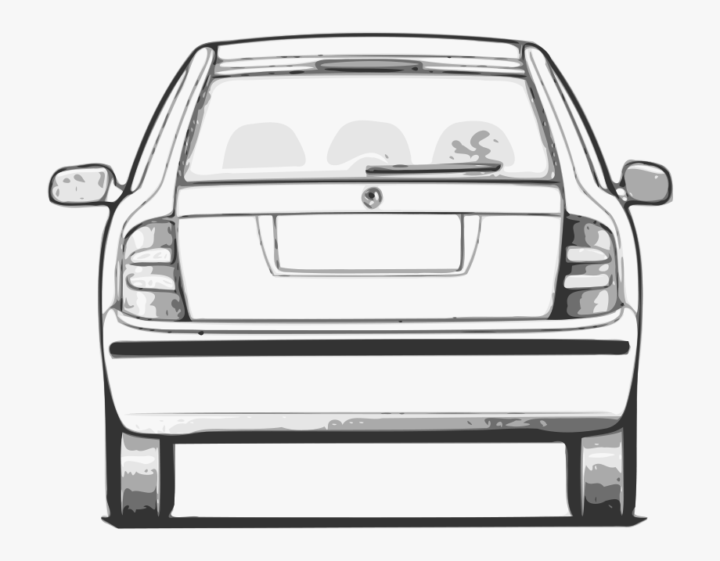
Question 19
What colour light on the back of a car tells you when a driver is slowing down or stopping?

Slide 22
Question 20
What type of sign is the shape below?

Slide 23
End of quiz, well done!
Please head back to the A*STARS website to find the answers.

